Slide 1
Data Mining: Data Preprocessing
lk3cwkd
Display
Week1 Lecture 2
EESHA TUR RAZIA BABAR

Slide 2
Outline
Attributes and Objects
Types of Data
Data Quality
Data Preprocessing

Slide 3
What is Data?
Collection of data objects and their attributes
An attribute is a property or characteristic of an object
Examples: eye color of a person, temperature, etc.
Attribute is also known as variable, field, characteristic, dimension, or feature
A collection of attributes describe an object
Object is also known as record, point, case, sample, entity, or instance
Attributes
Objects
Notes:
An attribute is a property or characteristic of an object
that may vary, either from one object to another or from one time to another.

Slide 4
Attribute Values
Attribute values are numbers or symbols assigned to an attribute for a particular object
Distinction between attributes and attribute values
Same attribute can be mapped to different attribute values
Example: height can be measured in feet or meters
Different attributes can be mapped to the same set of values
Example: Attribute values for ID and age are integers
Notes:
Both of these
attributes can be represented as integers. However, while it is reasonable to
talk about the average age of an employee, it makes no sense to talk about
the average employee ID. Indeed, the only aspect of employees that we want
to capture with the ID attribute is that they are distinct. Consequently, the
only valid operation for employee IDs is to test whether they are equal. There
is no hint of this limitation, however, when integers are used to represent the
employee ID attribute. For the age attribute, the properties of the integers
used to represent age are

Slide 5
Types of Attributes
There are different types of attributes
Nominal
Examples: ID numbers, eye color, zip codes
Ordinal
Examples: rankings (e.g., taste of potato chips on a scale from 1-10), grades, height {tall, medium, short}
Interval
Examples: calendar dates, temperatures in Celsius or Fahrenheit.
Ratio
Examples: temperature in Kelvin, length, counts, elapsed time (e.g., time to run a race)
Notes:
Interval does not have a true zero hence can represent values below zero
Temperature provides a good illustration
of some of the concepts that have been described. First, temperature
can be either an interval or a ratio attribute, depending on its measurement
scale. When measured on the Kelvin scale, a temperature of 2◦ is, in a physically
meaningful way, twice that of a temperature of 1◦. This is not true when
temperature is measured on either the Celsius or Fahrenheit scales, because,
physically, a temperature of 1◦ Fahrenheit (Celsius) is not much different than
a temperature of 2◦ Fahrenheit (Celsius). The problem is that the zero points
of the Fahrenheit and Celsius scales are, in a physical sense, arbitrary, and
therefore, the ratio of two Celsius or Fahrenheit temperatures is not physically
meaningful. Age of father can be twice as age of son but you cannot say similar for temperature in centigrades
Ration : cannot fall below 0

Slide 6
Properties of Attribute Values
The type of an attribute depends on which of the following properties/operations it possesses:
Distinctness: = ≠
Order: < >
Differences are + - meaningful :
Ratios are * / meaningful
Nominal attribute: distinctness
Ordinal attribute: distinctness & order
Interval attribute: distinctness, order & meaningful differences
Ratio attribute: all 4 properties/operations

Slide 7
Difference Between Ratio and Interval
Is it physically meaningful to say that a temperature of 10 ° is twice that of 5° on
the Celsius scale?
the Fahrenheit scale?
the Kelvin scale?
Consider measuring the height above average
If Bill’s height is three inches above average and Bob’s height is six inches above average, then would we say that Bob is twice as tall as Bill?
Is this situation analogous to that of temperature?

Slide 8
This categorization of attributes is due to S. S. Stevens
Notes:
Nominal and ordinal attributes are collectively referred to as categorical
or qualitative attributes. As the name suggests, qualitative attributes, such
as employee ID, lack most of the properties of numbers. Even if they are represented
by numbers, i.e., integers, they should be treated more like symbols.
The remaining two types of attributes, interval and ratio, are collectively referred
to as quantitative or numeric attributes. Quantitative attributes are
represented by numbers and have most of the properties of numbers. Note
that quantitative attributes can be integer-valued or continuous.

Slide 9
This categorization of attributes is due to S. S. Stevens
Notes:
The types of attributes can also be described in terms of transformations
that do not change the meaning of an attribute. Indeed, S. Smith Stevens, the
psychologist who originally defined the types of attributes shown in Table 2.2,
defined them in terms of these permissible transformations. For example,

Slide 10
Discrete and Continuous Attributes
Discrete Attribute
Has only a finite or countably infinite set of values
Examples: zip codes, counts, or the set of words in a collection of documents
Often represented as integer variables.
Note: binary attributes are a special case of discrete attributes
Continuous Attribute
Has real numbers as attribute values
Examples: temperature, height, or weight.
Practically, real values can only be measured and represented using a finite number of digits.
Continuous attributes are typically represented as floating-point variables.
Notes:
Binary attributes are a special case of discrete
attributes and assume only two values, e.g., true/false, yes/no,
male/female, or 0/1. Binary attributes are often represented as Boolean
variables, or as integer variables that only take the values 0 or 1.

Slide 11
Asymmetric Attributes
Only presence (a non-zero attribute value) is regarded as important
Words present in documents
Items present in customer transactions
If we met a friend in the grocery store would we ever say the following? “I see our purchases are very similar since we didn’t buy most of the same things.”
Notes:
For asymmetric attributes, only presence—a non-zero attribute value—is regarded
as important. Consider a data set where each object is a student and
To illustrate, if students
are compared on the basis of the courses they don’t take, then most students
would seem very similar, at least if the number of courses is large.
each attribute records whether or not a student took a particular course at
a university. For a specific student, an attribute has a value of 1 if the student
took the course associated with that attribute and a value of 0 otherwise.
Because students take only a small fraction of all available courses, most of
the values in such a data set would be 0. Therefore, it is more meaningful
and more efficient to focus on the non-zero values. To illustrate, if students
are compared on the basis of the courses they don’t take, then most students
would seem very similar, at least if the number of courses is large. Binary
attributes where only non-zero values are important are called asymmetric

Slide 12
Key Messages for Attribute Types
The types of operations you choose should be “meaningful” for the type of data you have
Distinctness, order, meaningful intervals, and meaningful ratios are only four (among many possible) properties of data
The data type you see – often numbers or strings – may not capture all the properties or may suggest properties that are not present
Analysis may depend on these other properties of the data
Many statistical analyses depend only on the distribution
In the end, what is meaningful can be specific to domain

Slide 13
Important Characteristics of Data
Dimensionality (number of attributes)
High dimensional data brings a number of challenges
Sparsity
Only presence counts
Resolution
Patterns depend on the scale
Size
Type of analysis may depend on size of data
Notes:
Dimensionality The dimensionality of a data set is the number of attributes
that the objects in the data set possess. Indeed, the difficulties associated with analyzing high-dimensional data
are sometimes referred to as the curse of dimensionality. Because of this,
an important motivation in preprocessing the data is dimensionality reduction.
Sparsity For some data sets, such as those with asymmetric features, most
attributes of an object have values of 0; in many cases, fewer than 1% of
the entries are non-zero. Recommendation system
Resolution It is frequently possible to obtain data at different levels of resolution,
and often the properties of the data are different at different resolutions.
For instance, the surface of the Earth seems very uneven at a resolution of a
If the resolution
is too fine, a pattern may not be visible or may be buried in noise; if the
resolution is too coarse, the pattern may disappear. For example, variations
in atmospheric pressure on a scale of hours reflect the movement of storms
and other weather systems. On a scale of months, such phenomena are not
detectable.

Slide 14
Types of data sets
Record
Data Matrix
Document Data
Transaction Data
Graph
World Wide Web
Molecular Structures
Ordered
Spatial Data
Temporal Data
Sequential Data
Genetic Sequence Data

Slide 15
Record Data
Data that consists of a collection of records, each of which consists of a fixed set of attributes
Notes:
Much data mining work assumes that the data set is a collection of records
(data objects), each of which consists of a fixed set of data fields (attributes).
For the most basic form of record data, there is no explicit
relationship among records or data fields, and every record (object) has the
same set of attributes. Record data is usually stored either in flat files or in
relational databases.

Slide 16
Data Matrix
If data objects have the same fixed set of numeric attributes, then the data objects can be thought of as points in a multi-dimensional space, where each dimension represents a distinct attribute
Such a data set can be represented by an m by n matrix, where there are m rows, one for each object, and n columns, one for each attribute
Notes:
If the data objects in a collection of data all have the
same fixed set of numeric attributes, then the data objects can be thought of as
sparse
points (vectors) in a multidimensional space, where each dimension represents
a distinct attribute describing the object. A set of such data objects can be
interpreted as an m by n matrix, where there are m rows, one for each object,

Slide 17
Document Data
Each document becomes a ‘term’ vector
Each term is a component (attribute) of the vector
The value of each component is the number of times the corresponding term occurs in the document.

Slide 18
Transaction Data
A special type of data, where
Each transaction involves a set of items.
For example, consider a grocery store. The set of products purchased by a customer during one shopping trip constitute a transaction, while the individual products that were purchased are the items.
Can represent transaction data as record data
Notes:
Transaction or Market Basket Data
The set of products purchased by a customer during one
shopping trip constitutes a transaction, while the individual products that
were purchased are the items. This type of data is called market basket
data because the items in each record are the products in a person’s “market
basket.”

Slide 19
Graph Data
Examples: Generic graph, a molecule, and webpages
Benzene Molecule: C6H6
Notes:
Data with Relationships among Objects The relationships among objects
frequently convey important information. In such cases, the data is often
represented as a graph. In particular, the data objects are mapped to nodes
of the graph, while the relationships among objects are captured by the links
between objects and link properties, such as direction and weight. Consider
Web pages on the World Wide Web, which contain both text and links to
other pages. In order to process search queries, Web search engines collect
and process Web pages to extract their contents. It is well known, however,
that the links to and from each page provide a great deal of information about
the relevance of a Web page to a query, and thus, must also be taken into
consideration. Figure 2.3(a) shows a set of linked Web pages.

Slide 20
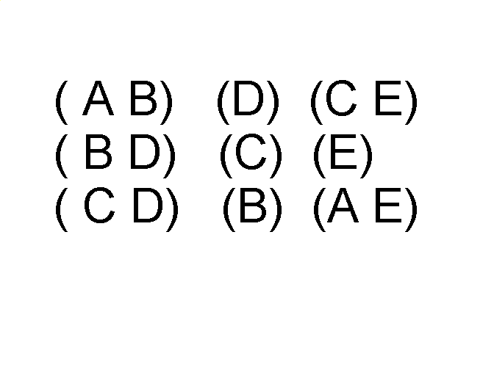
Ordered Data
Sequences of transactions
Items/Events
An element of the sequence

Slide 21
Ordered Data
Genomic sequence data

Slide 22
Ordered Data
Spatio-Temporal Data
Average Monthly Temperature of land and ocean
Notes:
Sprase data

Slide 23
Data Quality
Poor data quality negatively affects many data processing efforts
Data mining example: a classification model for detecting people who are loan risks is built using poor data
Some credit-worthy candidates are denied loans
More loans are given to individuals that default

Slide 24
Data Quality …
What kinds of data quality problems?
How can we detect problems with the data?
What can we do about these problems?
Examples of data quality problems:
Noise and outliers
Wrong data
Fake data
Missing values
Duplicate data

Slide 25
Noise
For objects, noise is an extraneous object
For attributes, noise refers to modification of original values
Examples: distortion of a person’s voice when talking on a poor phone and “snow” on television screen
The figures below show two sine waves of the same magnitude and different frequencies, the waves combined, and the two sine waves with random noise
The magnitude and shape of the original signal is distorted

Slide 26
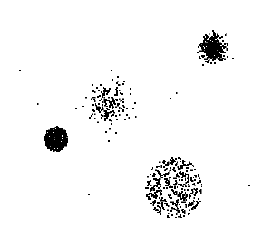
Outliers
Outliers are data objects with characteristics that are considerably different than most of the other data objects in the data set
Case 1: Outliers are noise that interferes with data analysis
Case 2: Outliers are the goal of our analysis
Credit card fraud
Intrusion detection
Causes?

Slide 27
Missing Values
Reasons for missing values
Information is not collected (e.g., people decline to give their age and weight)
Attributes may not be applicable to all cases (e.g., annual income is not applicable to children)
Handling missing values
Eliminate data objects or variables
Estimate missing values
Example: time series of temperature
Example: census results
Ignore the missing value during analysis

Slide 28
Duplicate Data
Data set may include data objects that are duplicates, or almost duplicates of one another
Major issue when merging data from heterogeneous sources
Examples:
Same person with multiple email addresses
Data cleaning
Process of dealing with duplicate data issues
When should duplicate data not be removed?

Slide 29
What is data exploration?
A preliminary exploration of the data to better understand its characteristics.
Key motivations of data exploration include
Helping to select the right tool for preprocessing or analysis
Making use of humans’ abilities to recognize patterns
People can recognize patterns not captured by data analysis tools
Related to the area of Exploratory Data Analysis (EDA)
Created by statistician John Tukey
Seminal book is Exploratory Data Analysis by Tukey
A nice online introduction can be found in Chapter 1 of the NIST/SEMATECH e-Handbook of Statistical Methods http://www.itl.nist.gov/div898/handbook/index.htm
Notes:
Exploratory Data Analysis (EDA

Slide 30
Techniques Used In Data Exploration
In EDA, as originally defined by Tukey
The focus was on visualization
Clustering and anomaly detection were viewed as exploratory techniques
In data mining, clustering and anomaly detection are major areas of interest, and not thought of as just exploratory
In our discussion of data exploration, we focus on
Summary statistics
Visualization

Slide 31

Iris Sample Data Set
Many of the exploratory data techniques are illustrated with the Iris Plant data set.
Can be obtained from the UCI Machine Learning Repository http://www.ics.uci.edu/~mlearn/MLRepository.html
From the statistician Douglas Fisher
Three flower types (classes):
Setosa
Virginica
Versicolour
Four (non-class) attributes
Sepal width and length
Petal width and length
Virginica. Robert H. Mohlenbrock. USDA NRCS. 1995. Northeast wetland flora: Field office guide to plant species. Northeast National Technical Center, Chester, PA. Courtesy of USDA NRCS Wetland Science Institute.

Slide 32
Iris Flower
Virginica. Robert H. Mohlenbrock. USDA NRCS. 1995. Northeast wetland flora: Field office guide to plant species. Northeast National Technical Center, Chester, PA. Courtesy of USDA NRCS Wetland Science Institute.

Slide 33
Summary Statistics
Summary statistics are numbers that summarize properties of the data
Summarized properties include frequency, location and spread
Examples: location - mean spread - standard deviation
Most summary statistics can be calculated in a single pass through the data

Slide 34
Frequency and Mode
The frequency of an attribute value is the percentage of time the value occurs in the data set
For example, given the attribute ‘gender’ and a representative population of people, the gender ‘female’ occurs about 50% of the time.
The mode of an attribute is the most frequent attribute value
The notions of frequency and mode are typically used with categorical data
Notes:
Consider a set of students who have an attribute, class, which
can take values from the set {freshman, sophomore, junior, senior}. Table
3.1 shows the number of students for each value of the class attribute. The
mode of the class attribute is freshman, with a frequency of 0.33. This may
indicate dropouts due to attrition or a larger than usual freshman class.

Slide 35
Percentiles
For continuous data, the notion of a percentile is more useful.
Given an ordinal or continuous attribute x and a number p between 0 and 100, the pth percentile is a value x_{p} of x such that p% of the observed values of x are less than x_{p}.
For instance, the 50th percentile is the value x_{50%} such that 50% of all values of x are less than x_{50%.} .

Slide 36
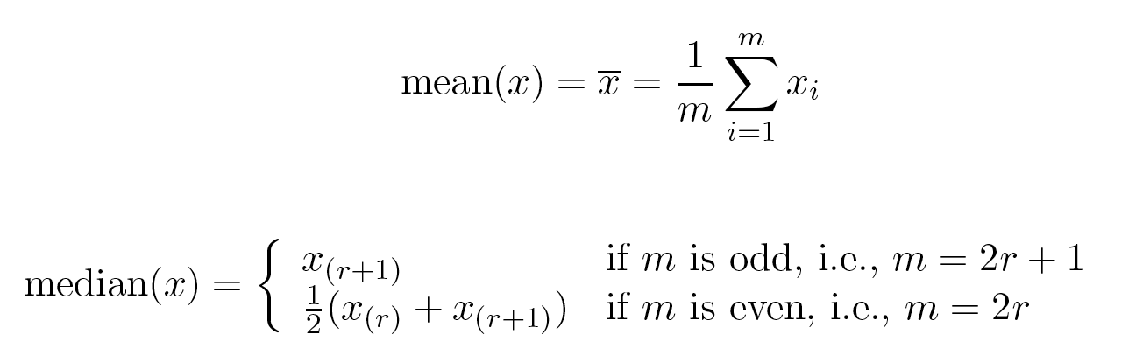
Measures of Location: Mean and Median
The mean is the most common measure of the location of a set of points.
However, the mean is very sensitive to outliers.
Thus, the median or a trimmed mean is also commonly used.
Notes:
To overcome problems with the traditional definition of a mean, the notion
of a trimmed mean is sometimes used. A percentage p between 0 and 100
is specified, the top and bottom (p/2)% of the data is thrown out, and the
mean is then calculated in the normal way. The median is a trimmed mean
with p = 100%, while the standard mean corresponds to p = 0%.
To summarize, the median is the middle value if there are an odd number
of values, and the average of the two middle values if the number of values
is even. Thus, for seven values, the median is x(4), while for ten values, the
median is 1
2 (x(5) + x(6)).

Slide 37
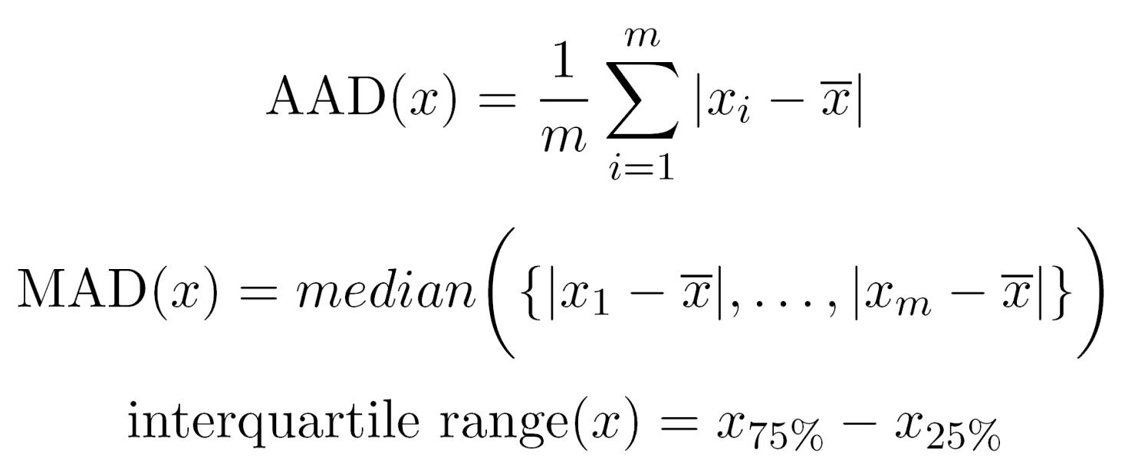
Measures of Spread: Range and Variance
Range is the difference between the max and min
The variance or standard deviation s_{x} is the most common measure of the spread of a set of points.
Because of outliers, other measures are often used.
Notes:
As a result, more robust estimates of the spread of a set
of values are often used. Following are the definitions of three such measures:
the absolute average deviation (AAD), the median absolute deviation
(MAD), and the interquartile range(IQR).

Slide 38
Visualization
Visualization is the conversion of data into a visual or tabular format so that the characteristics of the data and the relationships among data items or attributes can be analyzed or reported.
Visualization of data is one of the most powerful and appealing techniques for data exploration.
Humans have a well developed ability to analyze large amounts of information that is presented visually
Can detect general patterns and trends
Can detect outliers and unusual patterns

Slide 39
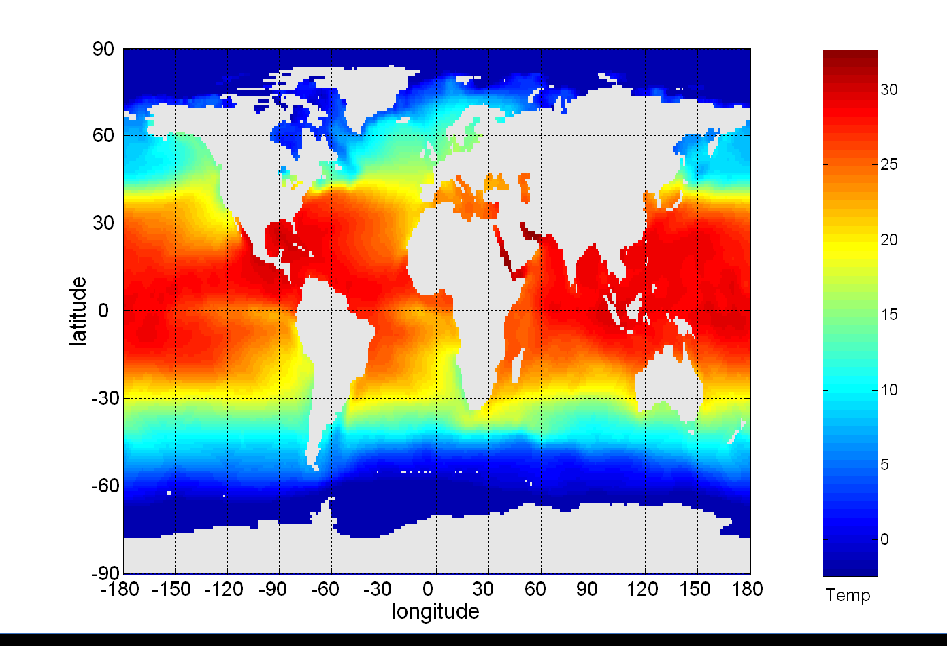
Example: Sea Surface Temperature
The following shows the Sea Surface Temperature (SST) for July 1982
Thousands of data points are summarized in a single figure

Slide 40
Representation
Is the mapping of information to a visual format
Data objects, their attributes, and the relationships among data objects are translated into graphical elements such as points, lines, shapes, and colors.
Example:
Objects are often represented as points
Their attribute values can be represented as the position of the points or the characteristics of the points, e.g., color, size, and shape
If position is used, then the relationships of points, i.e., whether they form groups or a point is an outlier, is easily perceived.

Slide 41
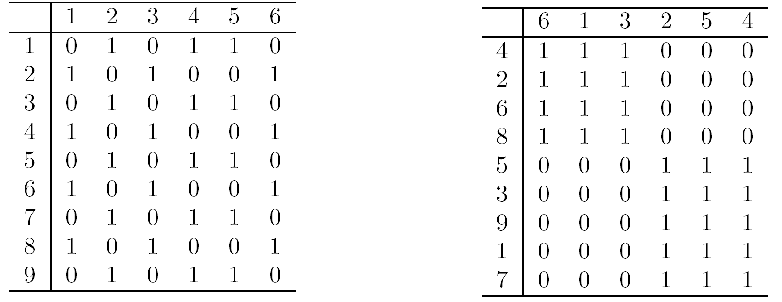
Arrangement
Is the placement of visual elements within a display
Can make a large difference in how easy it is to understand the data
Example:
Notes:
This example illustrates the importance of rearranging a table
of data. In Table 3.5, which shows nine objects with six binary attributes,
there is no clear relationship between objects and attributes, at least at first
glance. If the rows and columns of this table are permuted, however, as shown
in Table 3.6, then it is clear that there are really only two types of objects in
the table—one that has all ones for the first three attributes and one that has
only ones for the last three attributes.

Slide 42
Selection
Is the elimination or the de-emphasis of certain objects and attributes
Selection may involve the choosing a subset of attributes
Dimensionality reduction is often used to reduce the number of dimensions to two or three
Alternatively, pairs of attributes can be considered
Selection may also involve choosing a subset of objects
A region of the screen can only show so many points
Can sample, but want to preserve points in sparse areas
Notes:
The technique of selecting a pair (or small number) of attributes is a type of
dimensionality reduction, and there are many more sophisticated dimensionality
reduction techniques that can be employed, e.g., principal components
analysis (PCA).

Slide 43
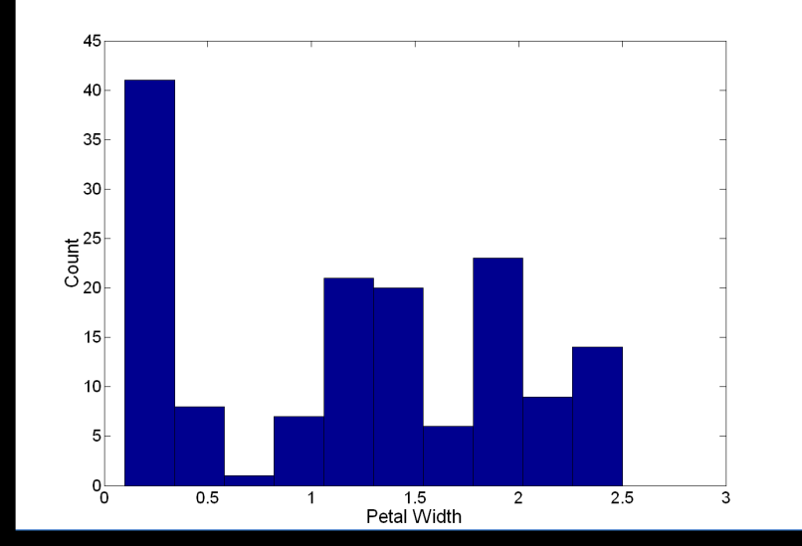
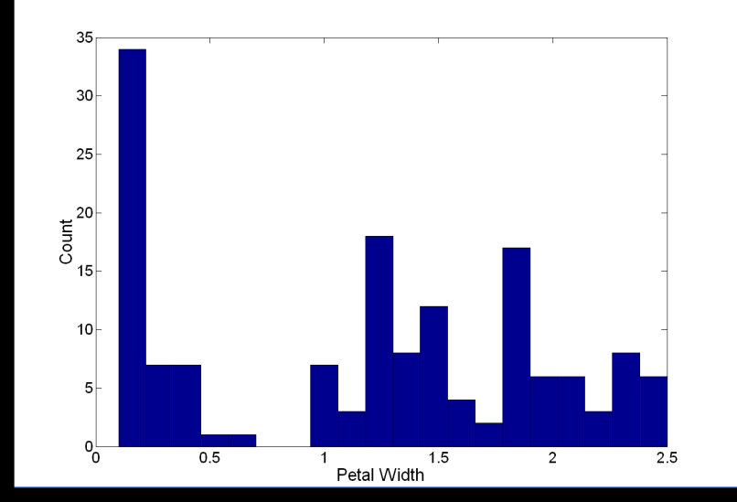
Visualization Techniques: Histograms
Histogram
Usually shows the distribution of values of a single variable
Divide the values into bins and show a bar plot of the number of objects in each bin.
The height of each bar indicates the number of objects
Shape of histogram depends on the number of bins
Example: Petal Width (10 and 20 bins, respectively)
Notes:
For continuous attributes, the range of values is divided
into bins—typically, but not necessarily, of equal width—and the values
in each bin are counted.

Slide 44
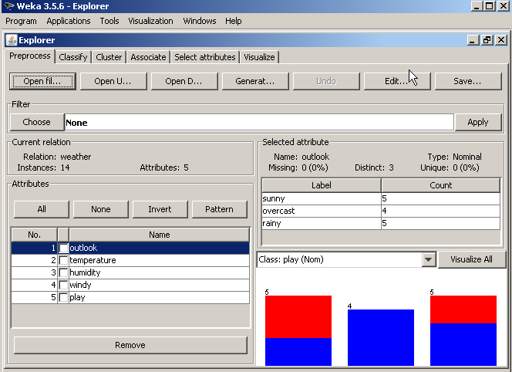
Histogram from Weka
Notes:
As soon as the data is loaded, more choices in Weka are available. Among many:
Editting the data set
Select a type of the studies that we would like to do, etc
We will be focusing on some classification studies today!

Slide 45
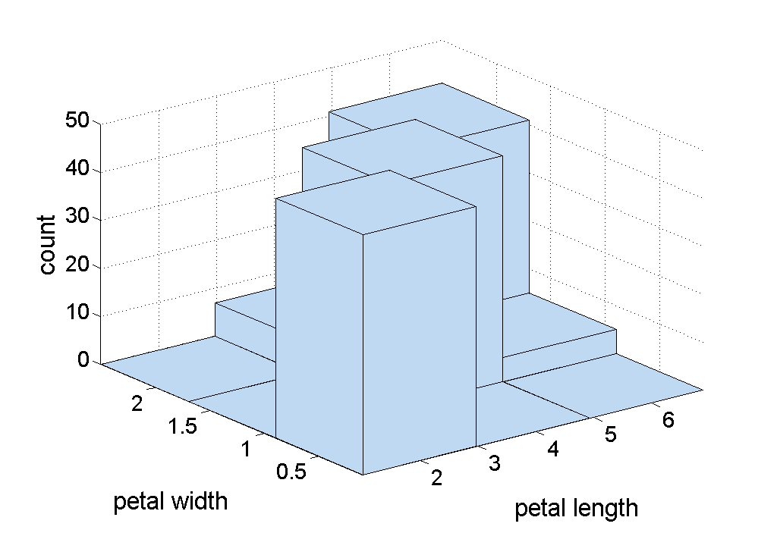
Two-Dimensional Histograms
Show the joint distribution of the values of two attributes
Example: petal width and petal length
What does this tell us?
Notes:
While two-dimensional histograms can be used to discover interesting facts
about how the values of two attributes co-occur, they are visually more complicated.

Slide 46
Visualization Techniques: Box Plots
Box Plots
Invented by J. Tukey
Another way of displaying the distribution of data
Following figure shows the basic part of a box plot
outlier
90th percentile
75th percentile
50th percentile
25th percentile
10th percentile

Slide 47
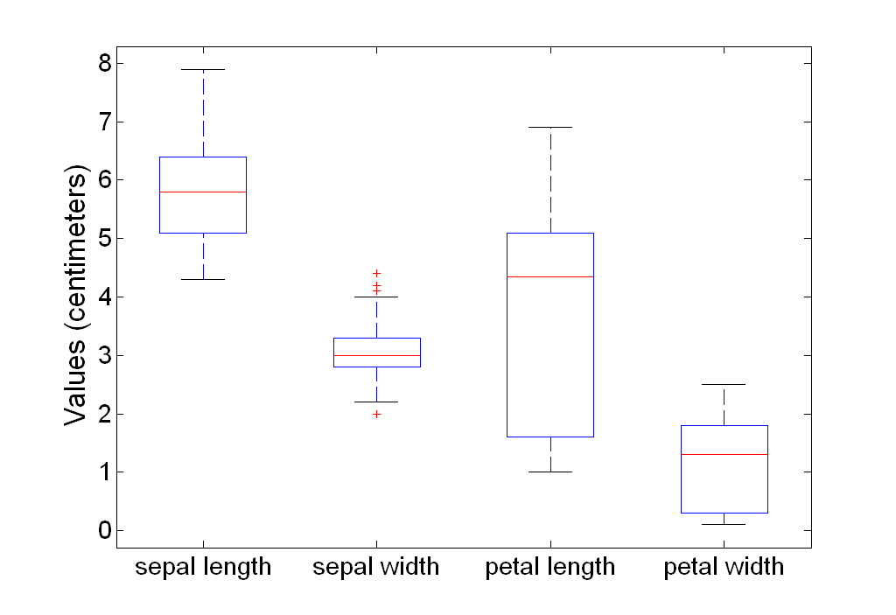
Example of Box Plots
Box plots can be used to compare attributes

Slide 48
Visualization Techniques: Scatter Plots
Scatter plots
Attributes values determine the position
Two-dimensional scatter plots most common, but can have three-dimensional scatter plots
Often additional attributes can be displayed by using the size, shape, and color of the markers that represent the objects
It is useful to have arrays of scatter plots can compactly summarize the relationships of several pairs of attributes
See example on the next slide

Slide 49
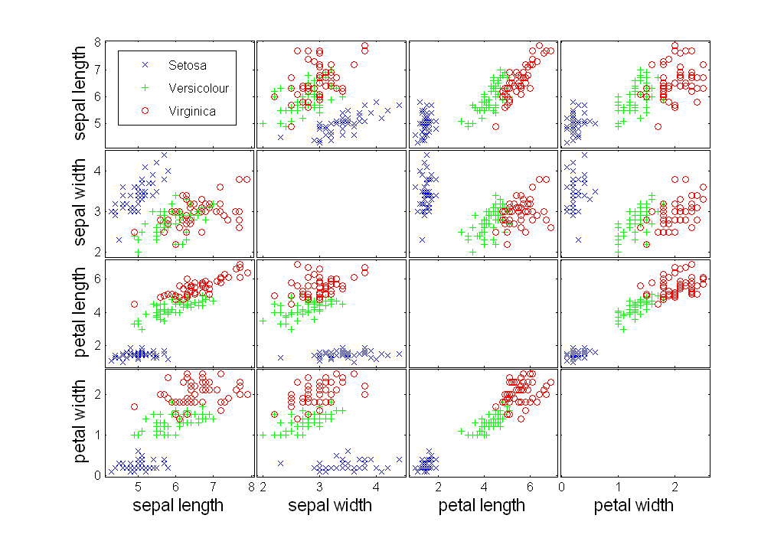
Scatter Plot Array of Iris Attributes
Notes:
There are two main uses for scatter plots. First, they graphically show
the relationship between two attributes. In Section 2.4.5, we saw how scatter
plots could be used to judge the degree of linear correlation. (See Figure 2.17.)
Scatter plots can also be used to detect non-linear relationships, either directly
or by using a scatter plot of the transformed attributes.
Second, when class labels are available, they can be used to investigate the
degree to which two attributes separate the classes. If is possible to draw a
line (or a more complicated curve) that divides the plane defined by the two
attributes into separate regions that contain mostly objects of one class, then
it is possible to construct an accurate classifier based on the specified pair of
attributes. If

Slide 50
Visualization Techniques: Contour Plots
Contour plots
Useful when a continuous attribute is measured on a spatial grid
They partition the plane into regions of similar values
The contour lines that form the boundaries of these regions connect points with equal values
The most common example is contour maps of elevation
Can also display temperature, rainfall, air pressure, etc.
An example for Sea Surface Temperature (SST) is provided on the next slide

Slide 51
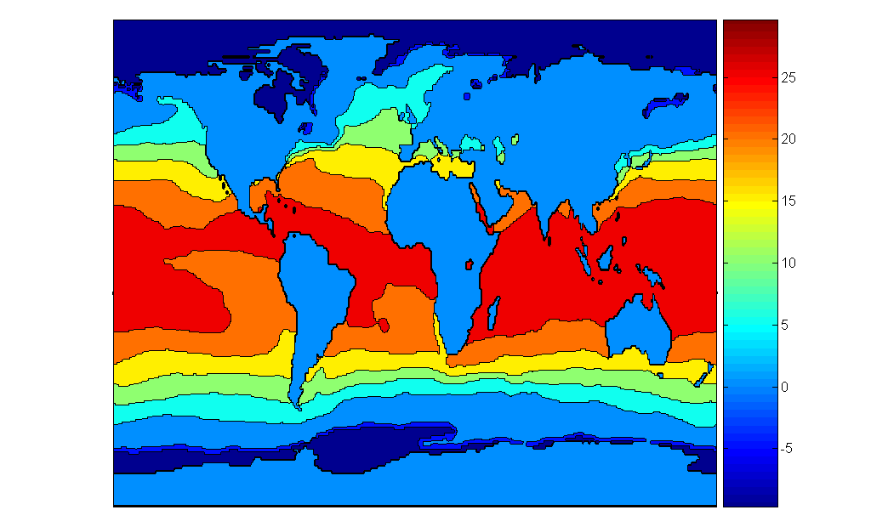
Contour Plot Example: SST Dec, 1998
Celsius

Slide 52
Visualization Techniques: Matrix Plots
Matrix plots
Can plot the data matrix
This can be useful when objects are sorted according to class
Typically, the attributes are normalized to prevent one attribute from dominating the plot
Plots of similarity or distance matrices can also be useful for visualizing the relationships between objects
Examples of matrix plots are presented on the next two slides

Slide 53
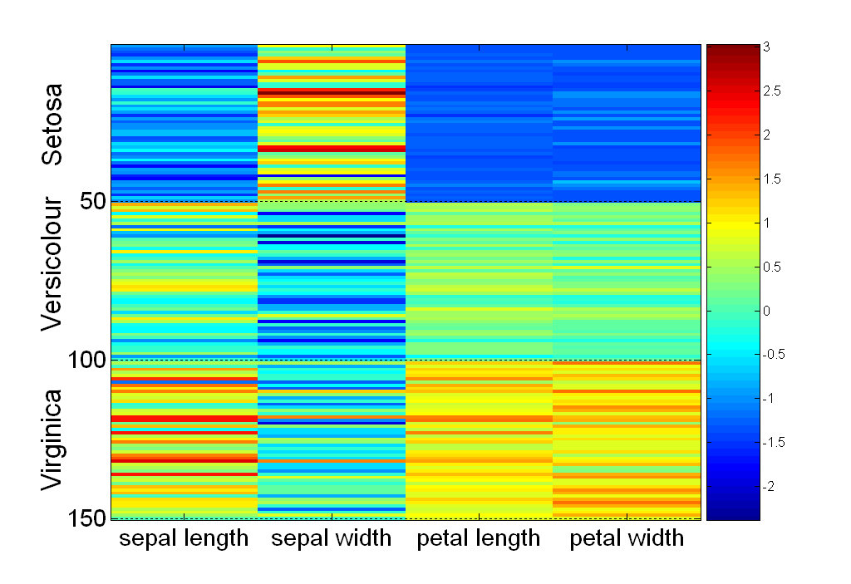
Visualization of the Iris Data Matrix
standard
deviation

Slide 54
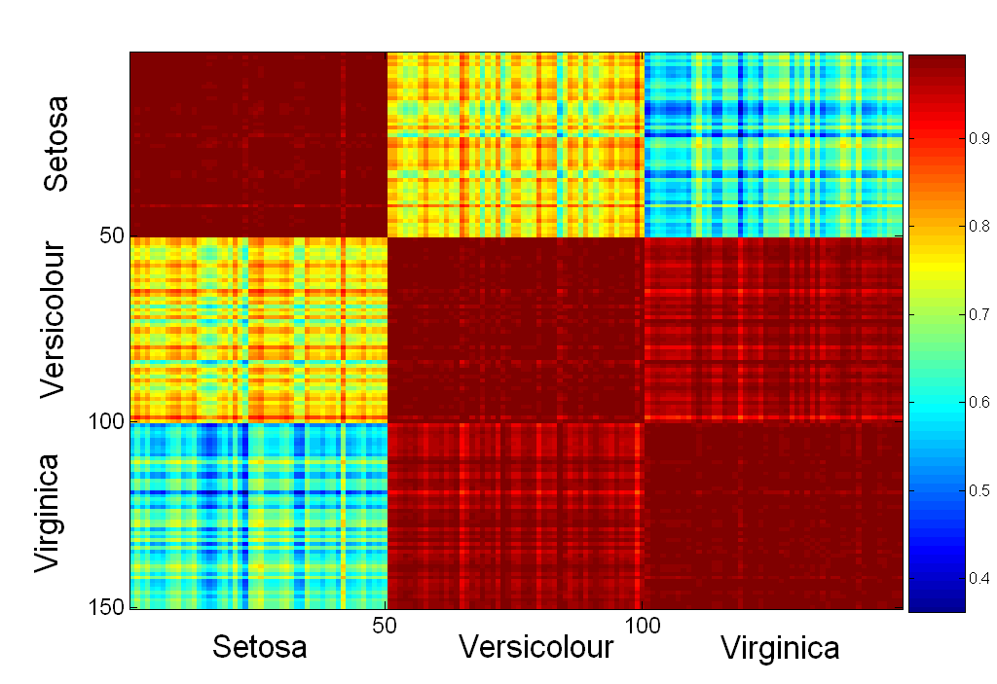
Visualization of the Iris Correlation Matrix
Notes:
Pie Charts,
Matplotlib. Matplotlib is one of the best python data visualization libraries for generating powerful yet simple visualization. ...
Plotly. ...
Seaborn. ...
GGplot. ...
Altair. ...
Bokeh. ...
Pygal. ...
Geoplotlib.

Slide 55
Data Preprocessing
Aggregation
Sampling
Discretization and Binarization
Attribute Transformation
Dimensionality Reduction
Feature subset selection
Feature creation

Slide 56
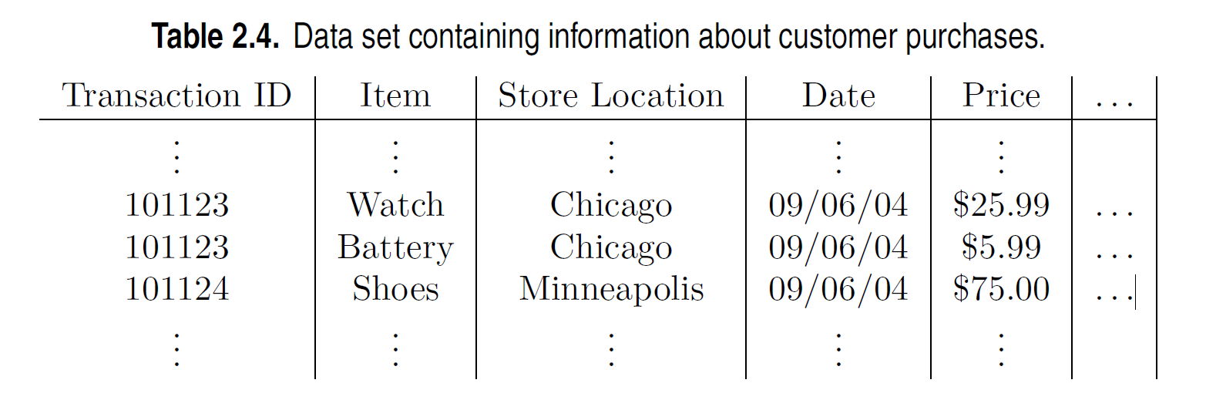
Aggregation
Combining two or more attributes (or objects) into a single attribute (or object)
Purpose
Data reduction - reduce the number of attributes or objects
Change of scale
Cities aggregated into regions, states, countries, etc.
Days aggregated into weeks, months, or years
More “stable” data - aggregated data tends to have less variability

Slide 57
Example: Precipitation in Australia
This example is based on precipitation in Australia from the period 1982 to 1993.
The next slide shows
A histogram for the standard deviation of average monthly precipitation for 3,030 0.5◦ by 0.5◦ grid cells in Australia, and
A histogram for the standard deviation of the average yearly precipitation for the same locations.
The average yearly precipitation has less variability than the average monthly precipitation.
All precipitation measurements (and their standard deviations) are in centimeters.

Slide 58
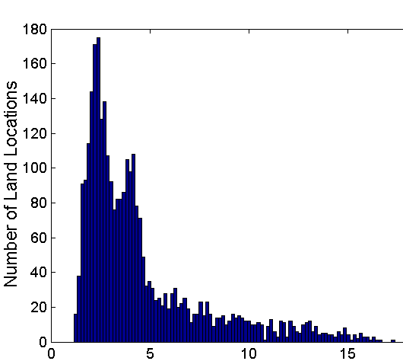
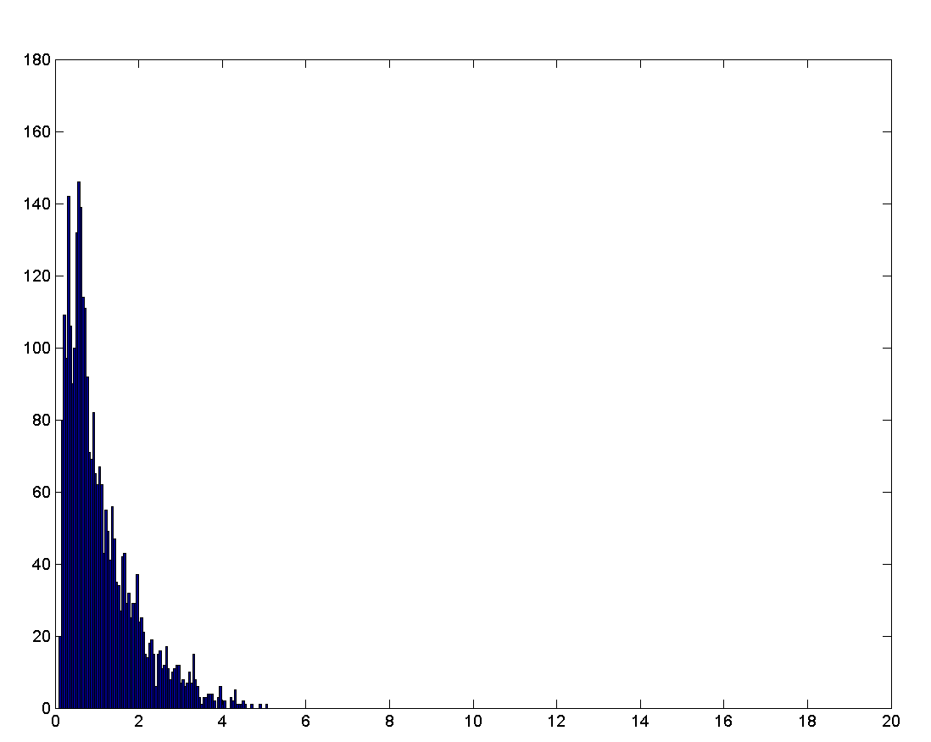
Example: Precipitation in Australia …
Variation of Precipitation in Australia
Standard Deviation of Average Monthly Precipitation
Standard Deviation of Average Yearly Precipitation

Slide 59
Sampling
Sampling is the main technique employed for data reduction.
It is often used for both the preliminary investigation of the data and the final data analysis.
Statisticians often sample because obtaining the entire set of data of interest is too expensive or time consuming.
Sampling is typically used in data mining because processing the entire set of data of interest is too expensive or time consuming.

Slide 60
Sampling …
The key principle for effective sampling is the following:
Using a sample will work almost as well as using the entire data set, if the sample is representative
A sample is representative if it has approximately the same properties (of interest) as the original set of data

Slide 61

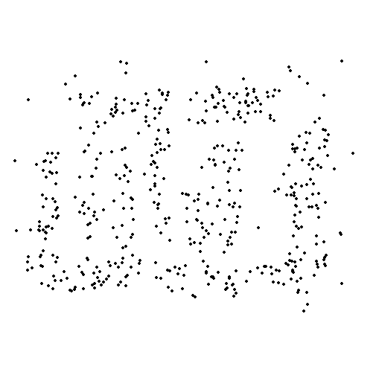
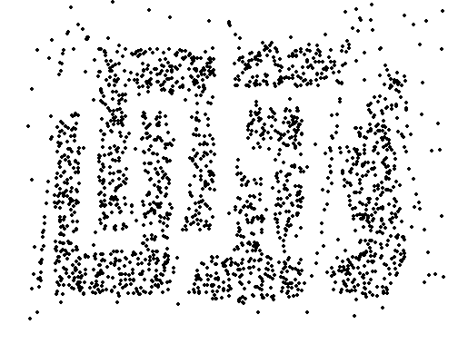
Sample Size
8000 points 2000 Points 500 Points

Slide 62
Types of Sampling
Simple Random Sampling
There is an equal probability of selecting any particular item
Sampling without replacement
As each item is selected, it is removed from the population
Sampling with replacement
Objects are not removed from the population as they are selected for the sample.
In sampling with replacement, the same object can be picked up more than once
Stratified sampling
Split the data into several partitions; then draw random samples from each partition
Notes:
Hence, a sampling
scheme that can accommodate differing frequencies for the items of interest is
needed. Stratified sampling, which starts with prespecified groups of objects,
is such an approach. In the simplest version, equal numbers of objects
are drawn from each group even though the groups are of different sizes. In another
variation, the number of objects drawn from each group is proportional
to the size of that group.

Slide 63
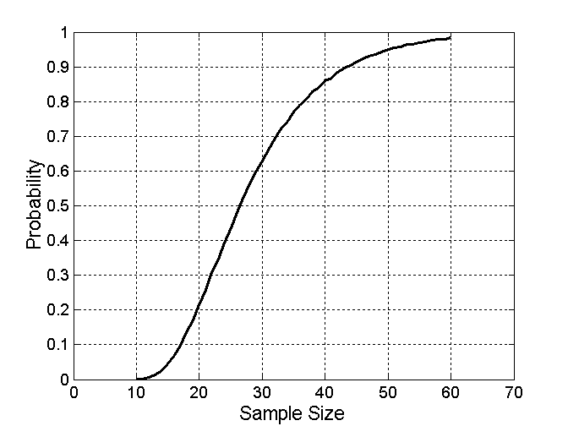
Sample Size
What sample size is necessary to get at least one object from each of 10 equal-sized groups.

Slide 64
Discretization
Discretization is the process of converting a continuous attribute into an ordinal attribute
A potentially infinite number of values are mapped into a small number of categories
Discretization is used in both unsupervised and supervised settings

Slide 65
Binarization
Binarization maps a continuous or categorical attribute into one or more binary variables
Notes:
Simplification of data: Binarization simplifies data by converting it into a binary form, making it easier to process and analyze

Slide 66
Attribute Transformation
An attribute transform is a function that maps the entire set of values of a given attribute to a new set of replacement values such that each old value can be identified with one of the new values
Simple functions: x^{k}, log(x), e^{x}, |x|
Normalization
Refers to various techniques to adjust to differences among attributes in terms of frequency of occurrence, mean, variance, range
Take out unwanted, common signal, e.g., seasonality
In statistics, standardization refers to subtracting off the means and dividing by the standard deviation

Slide 67
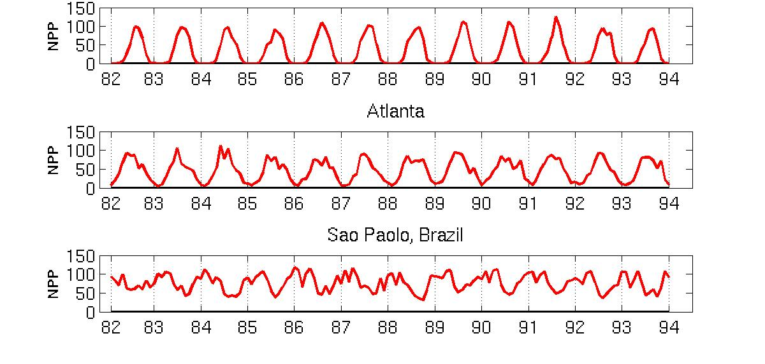
Example: Sample Time Series of Plant Growth
Minneapolis
Net Primary Production (NPP) is a measure of plant growth used by ecosystem scientists.
Correlations between time series
Correlations between time series

Slide 68
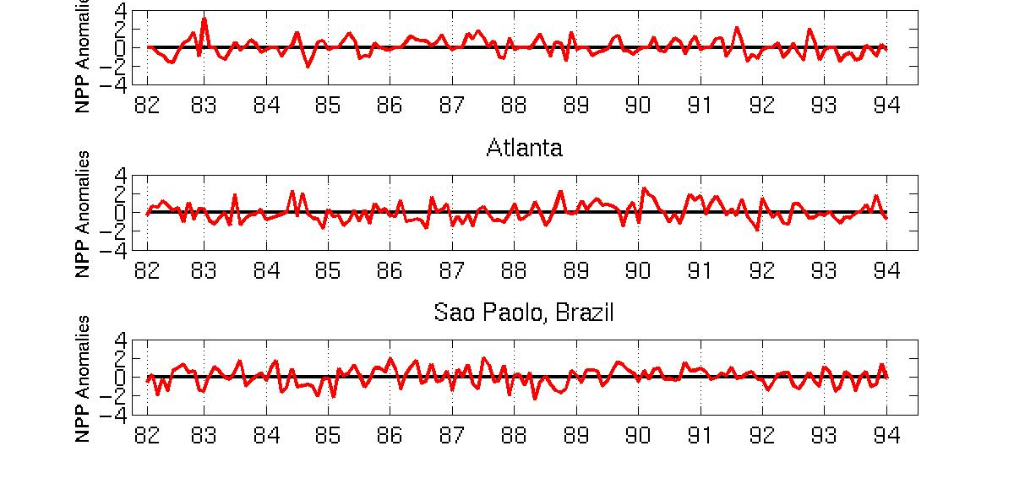
Seasonality Accounts for Much Correlation
Minneapolis
Normalized using monthly Z Score:
Subtract off monthly mean and divide by monthly standard deviation
Correlations between time series
Correlations between time series

Slide 69
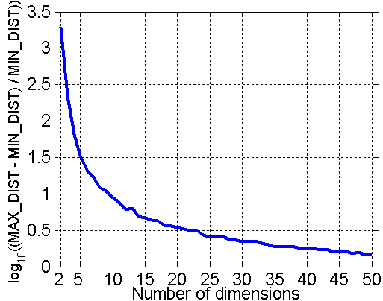
Curse of Dimensionality
When dimensionality increases, data becomes increasingly sparse in the space that it occupies
Definitions of density and distance between points, which are critical for clustering and outlier detection, become less meaningful
Randomly generate 500 points
Compute difference between max and min distance between any pair of points

Slide 70
Dimensionality Reduction
Purpose:
Avoid curse of dimensionality
Reduce amount of time and memory required by data mining algorithms
Allow data to be more easily visualized
May help to eliminate irrelevant features or reduce noise
Techniques
Principal Components Analysis (PCA)
Singular Value Decomposition
Others: supervised and non-linear techniques

Slide 71
Dimensionality Reduction: PCA
Goal is to find a projection that captures the largest amount of variation in data
x₂
e
x₁
Notes:
Principal
Components Analysis (PCA) is a linear algebra technique for continuous
attributes that finds new attributes (principal components) that (1) are linear
combinations of the original attributes, (2) are orthogonal (perpendicular) to
each other, and (3) capture the maximum amount of variation in the data. For
example, the first two principal components capture as much of the variation
in the data as is possible with two orthogonal attributes that are linear combinations
of the original attributes.

Slide 72
Feature Subset Selection
Another way to reduce dimensionality of data
Redundant features
Duplicate much or all of the information contained in one or more other attributes
Example: purchase price of a product and the amount of sales tax paid
Irrelevant features
Contain no information that is useful for the data mining task at hand
Example: students' ID is often irrelevant to the task of predicting students' GPA
Many techniques developed, especially for classification
Notes:
Filter approaches
Wrapper approaches

Slide 73
Feature Creation
Create new attributes that can capture the important information in a data set much more efficiently than the original attributes
Three general methodologies:
Feature extraction
Example: extracting edges from images
Feature construction
Example: dividing mass by volume to get density
Mapping data to new space
Example: Fourier and wavelet analysis

Slide 74
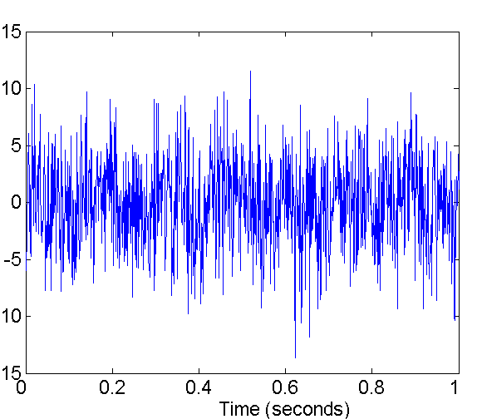
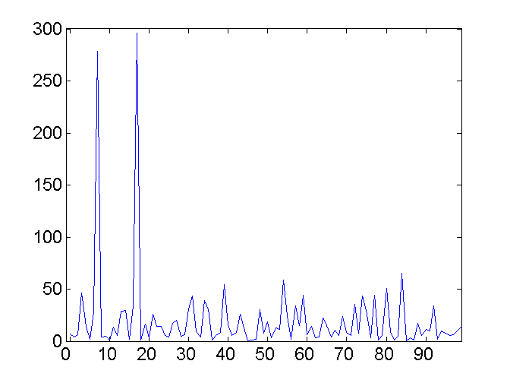
Mapping Data to a New Space
Fourier and wavelet transform
Frequency
Two Sine Waves + Noise
Frequency

